Slide 1
NEWSTIME It’s the way the news goes.

Slide 2
Overview
Interface
Architecture
Labeler
Classifier
Database
Hardships
.
.

Slide 3
1. Overview
Newstime is a platform that aggregates news articles and clusters them into news stories.
.
.

Slide 4
1. Overview
Articles are fetched from major news providers, analyzed using an online text processing service, and stored in a local MongoDB database.
.

Slide 5
1. Overview
They are then grouped together to form news stories that a user can search for from the website.
.

Slide 6
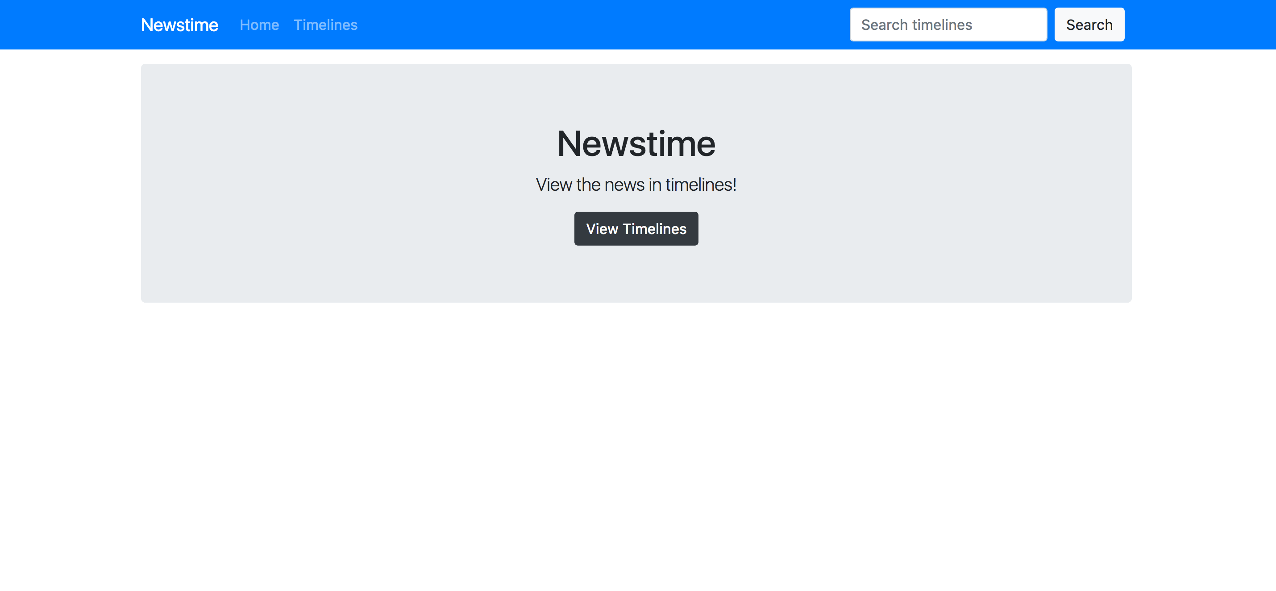
Search for news stories
2. Interface
.
Browse suggested stories

Slide 7
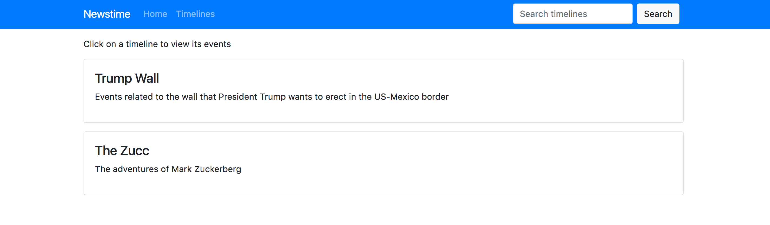
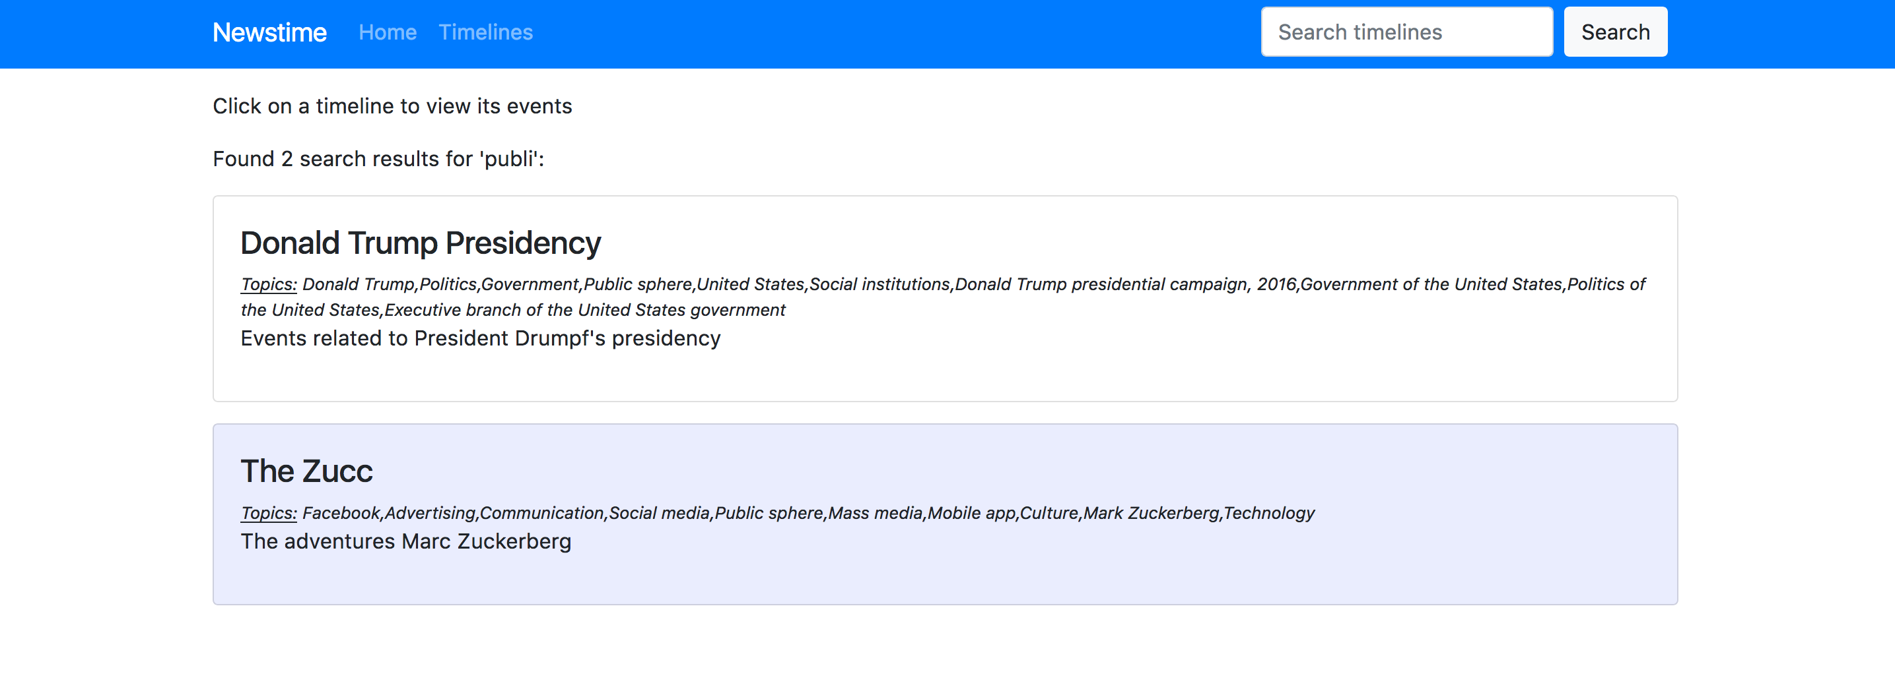
2. Interface
.

Slide 8
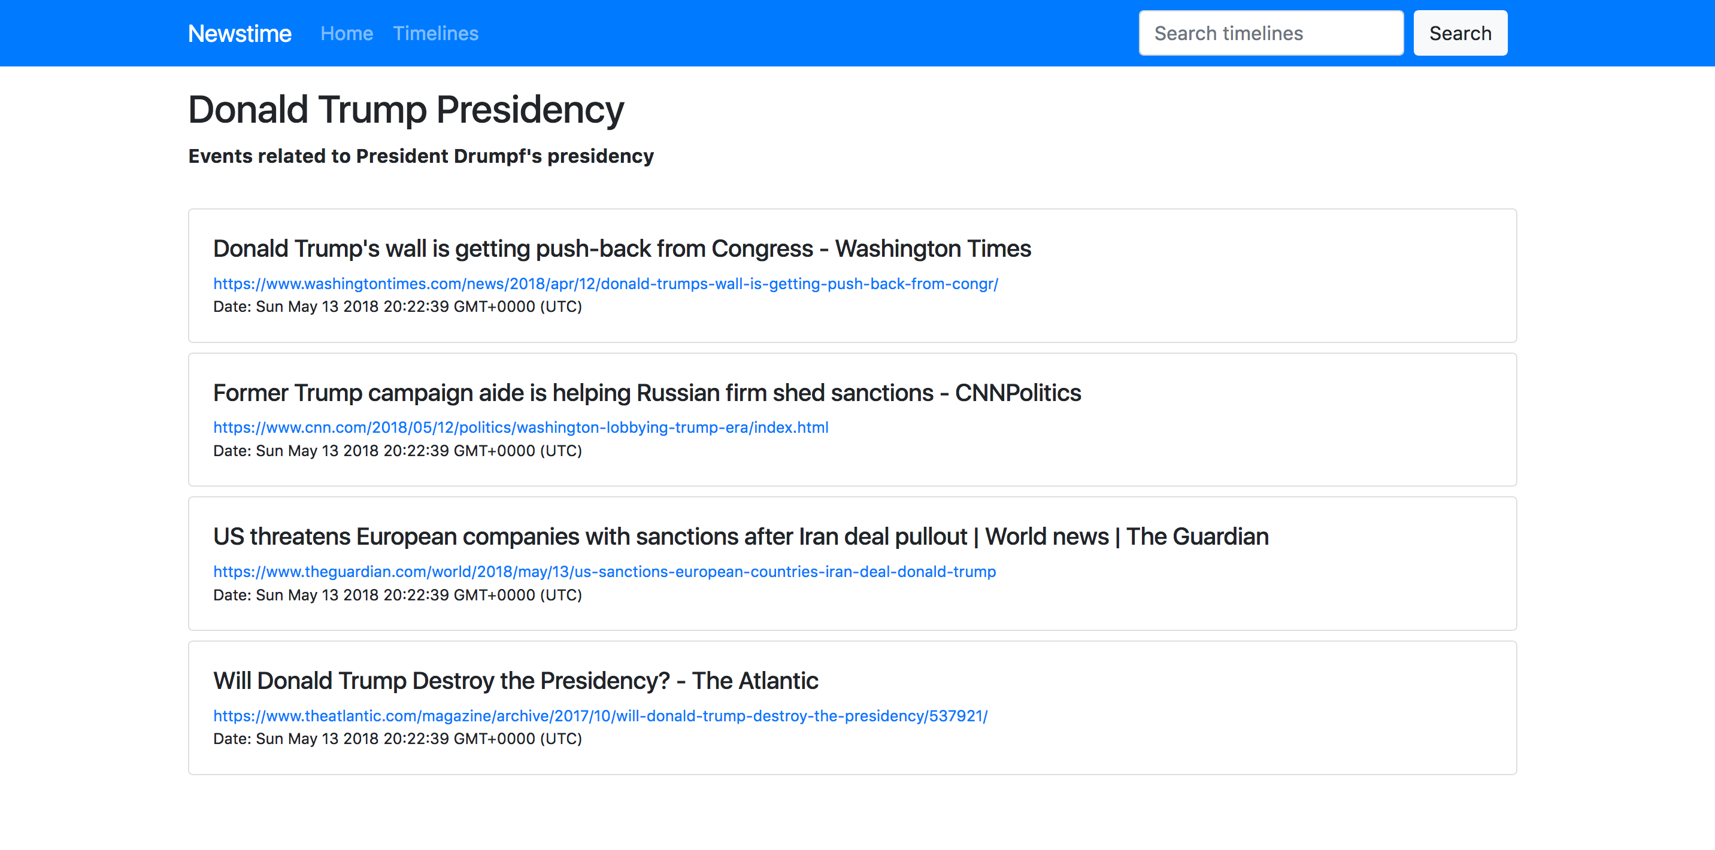
2. Interface
.

Slide 9
3. Architecture
3. 1. Labeler
The labeler interfaces with TextRazor, an online natural language processing tool, to extract keywords from an article.

Slide 10
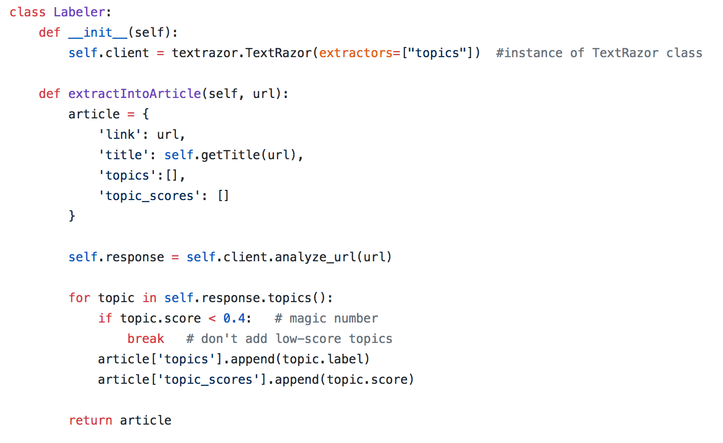
3. 1. Labeler

Slide 11
3. 1. Labeler
After keywords have been extracted for an article, and the article’s title fetched from the the labeler creates an article object that contains the following information: article link, article title, keywords, and keyword scores (confidence level returned by TextRazor for each keyword).

Slide 12
3. 2. Classifier
Articles are added to the database one by one. The Classifier decides whether they belong to a news story using the getSimilarityScore function, which compares two lists of keywords to identify similar content.
.
.
.
.

Slide 13
3. 2. Classifier
News stories are created by a clustering component that checks the similarity scores of articles and applies hierarchical clustering to identify common topics among a group of articles. A list of the articles in each group is added to an object called a Timeline (not completed). In our application, Timelines are created manually.
.

Slide 14
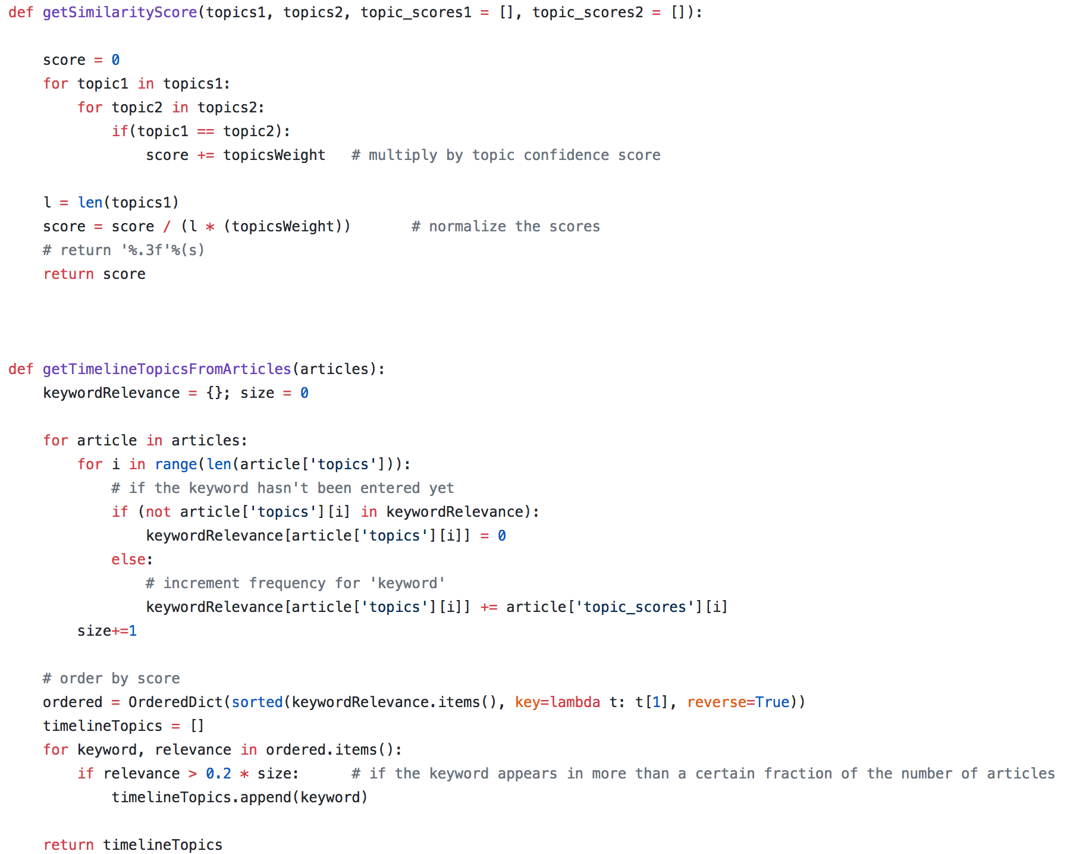
3. 2. Classifier
Articles are added to the databa decides

Slide 15
3. 3. Database
MongoDB gives the option of storing our data either on a local database or a remote database. The articles

Slide 16
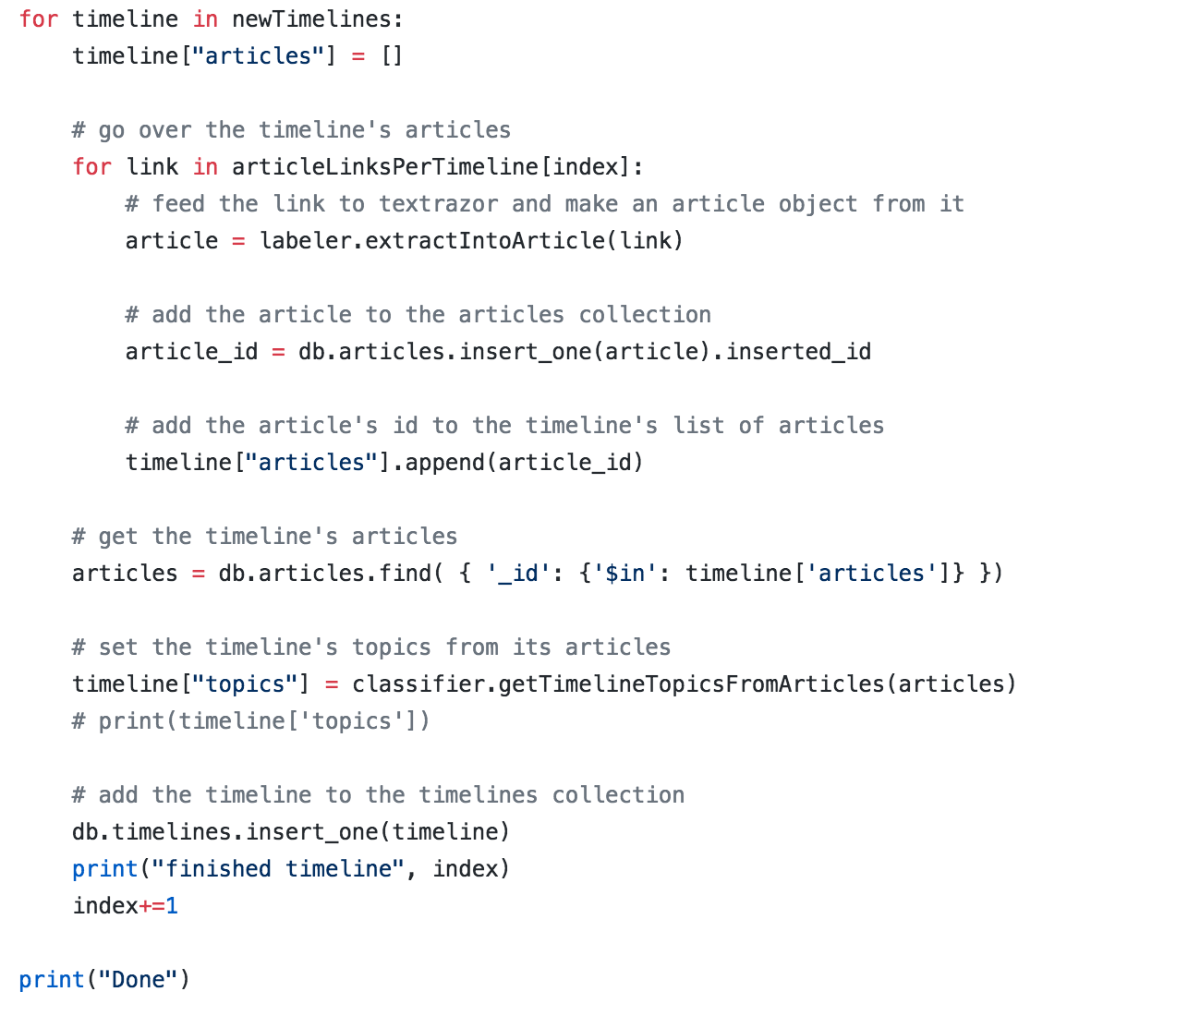
3. 3. Database
MongoDB gives the option of storing our data either on a local database or a remote database. The articles

Slide 17
4. Hardships
Generating timelines automatically proved challenging, because news stories are very difficult to identify using common clustering techniques. We tried using PageRank, but ran into the problem of differentiating multiple groups of highly correlated articles as different stories.

Slide 18
4. Hardships
Another challenge was to extract the date of a news article. We first thought of using temporal augmentation to find out the major events from references to dates in the text. Not only was this was very difficult, but we also found out that extracting the publication date from the article was tricky because of the different date formats each news provider uses.

Slide 19
Thank you!
Karl Hayek, Tarek Tohme, Alexandre Megarbane, Elie Tamer

